Slide 1
Elliptic Curve Cryptography
Presented by:
Rahul Gupta
Ayush Govil

Slide 2
Introduction
ECC belongs to the category of Public-key cryptography, performs computations using elliptic curve arithmetic instead of integer or polynomial arithmetic.
ECC provides equally good security compared to RSA, but uses smaller key size.
ECC supports very fast key generation so encryption and decryption is fast in ECC when compared to RSA.
ECC computations uses less memory and CPU cycles compares to RSA , hence suited for securing Mobile handheld devices.

Slide 3
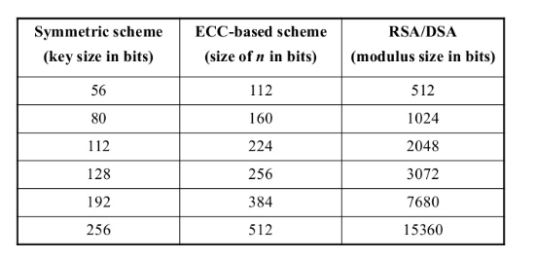
Comparison for Key Sizes for equivalent security

Slide 4
An elliptic curve is defined by an equation in two variables with coefficients.
Elliptic curves are not ellipses rather described by cubic equations similar to those used for calculating the circumference of an ellipse. Variables and coefficients are restricted to elements of a finite fields.
ECC relies on the difficulty of Elliptic Curve discrete logarithm problem(ECDLP). The security of ECC is defined by this.

Slide 5

How ECC works

Slide 6
Applications of ECC
Elliptic curve cryptography used for encryption/decryption of messages, generation and verification of digital signatures, pseudo-random generators. It Is also used in several integer factorization algorithm.

Slide 7

Diffie-Hellman Key Exchange

Slide 8
How ECDSA works
Let’s consider Alice is signer and Bob is receiver here:
Both knows:
What elliptic curve to use
order if the curve(no. of points in the curve, n)
Coordinates of a base point G
Alice holds a private key d and Bob hold the public key P=dG.
Alice uses a random number k and calculates KG, using coordinates(x,y).
Alice hashes the messages using some algorithm(SHA-256) to form h.
Signature generated is (r,s):
r= x mod n.
s=(h+rd) /k mod n
Both r and s 256 bits long. Hence, signature is 512 bits long.

Slide 9
Drawbacks
If k is used again and again, it can be calculated by attackers. This happened with PlayStation 3 in 2010.
Malicious client could trick server into using the wrong curve exposing server’s secret key.
Public key cryptography is computationally more expensive than private key encryption. In wireless devices, public key encryption can shorten the lifetime of batteries or of the devices themselves.
ECC requires some agreement on which type of curve and curve parameters to use. RSA is still much better researched than ECC.

Slide 10
Thank You

